Slide 1
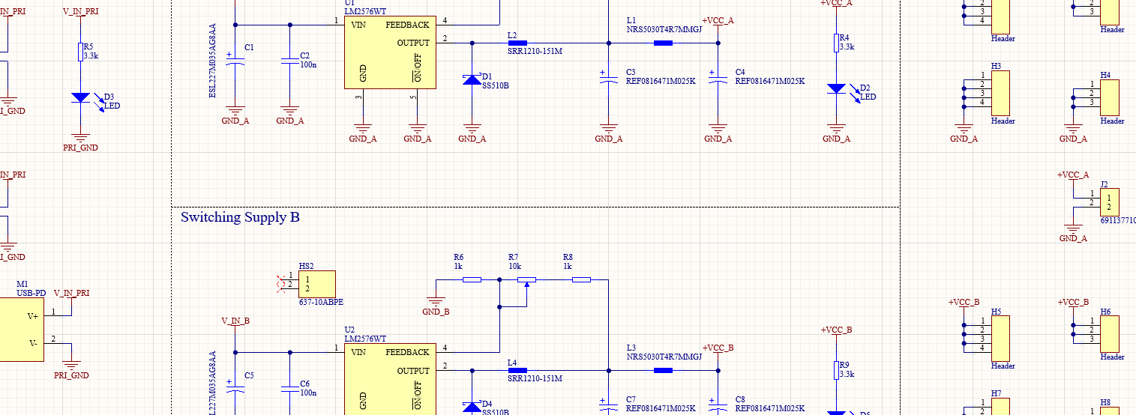

IEEE PCB Design Workshop: (Week 01) Introduction to Schematics
<N
Hosted By: Adrian Sucahyo and IEEE at the University of Utah
Adapted From: IEEE x FSAE Workshop SP25 with Nick Howard and Adrian Sucahyo

Slide 2

Workshop Outline
Tentatively scheduled for ~9 weeks
Sept. 3 – Introduction to Schematics
Sept. 10 – Schematics Continued
Sept. 17 – Introduction to PCB Layout
Sept. 24 – Layout Continued
Oct. 1 – Open Work Session
** FALL BREAK **
Oct. 22 – Soldering Week 1
Oct. 29 – Soldering Week 2
Nov. 5 – Soldering Week 3
Nov. 12 – Final Notes and Next Steps

Slide 3
Workshop Logistics
We highly recommend attending all workshop sessions
Each session is designed to build off previously discussed materials
By the end of the workshop, you will be able to:
Build an adjustable USB-C Breadboard Power Supply
Understand the basics of schematic layout, PCB layout, and board manufacturing
Gain experience with through-hole and surface mount PCB assembly
Have a basic understanding of manufacturing techniques and equipment used in the industry

Slide 4
Workshop Logistics
We hope to not charge a fee for this workshop and supporting materials
Tentative on ASUU funding for the Fall Semester
Will know by October if fees will be necessary
Want to pursue a different project? Chat or Email Us!
We may be able to support individual projects get board manufactured

Slide 5


Want more experience?
Consider joining the FSAE tractive team!
The Tractive Team is currently looking for students to assist with designing and assembling the electrical system for an electric formula-style race car!
No experience required!

Slide 6


Join the IEEE Discord
If you haven’t already, please join the IEEE Discord server for additional information and updates regarding this workshop

Slide 7
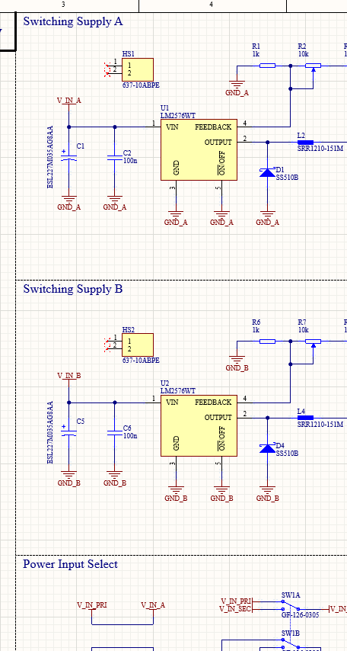
What is a schematic?
Schematics are a graphical representation of an electrical circuit or system
A step up from a block diagram
Shows all parts and electrical connections in a circuit
Used to route PCB traces during layout
Schematics are NOT a physical representation of component positions on the PCB

Slide 8
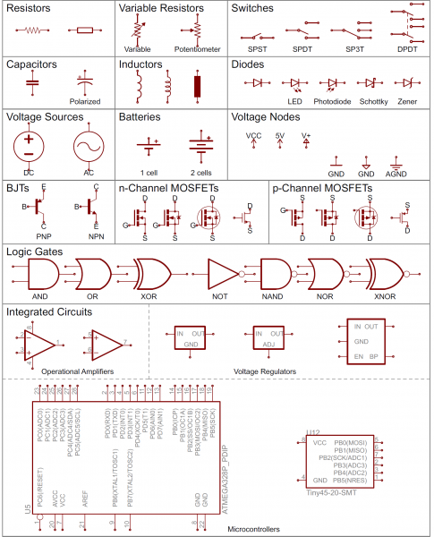
Components in a Schematic
Every electrical component will have its own symbol within the schematic
Contains all pins connected to the component
May contain additional information such as signal type
Relatively consistent across platforms
https://learn.sparkfun.com/tutorials/how-to-read-a-schematic/all

Slide 9
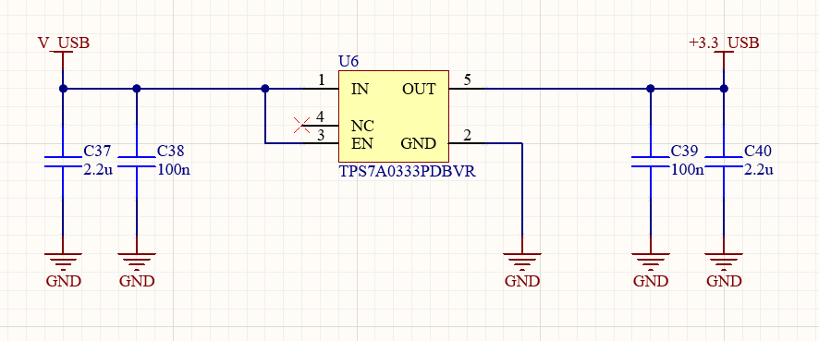
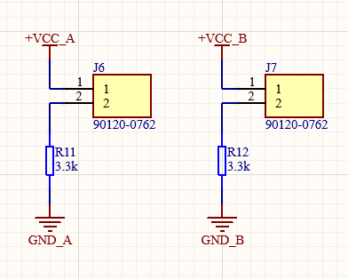
Symbol Attributes
Symbols may have additional information regarding the component they represent
Designators
Values
Part Numbers
Pin Name
Pin Number

Slide 10
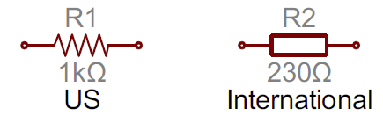
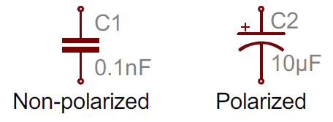
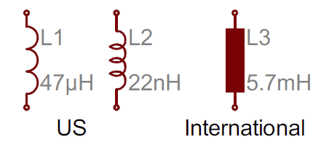
US vs International Symbols
You may see variations on certain components between US and International Schematics
Resistors, Capacitors, Inductors and more may have slightly different schematic symbols
https://learn.sparkfun.com/tutorials/how-to-read-a-schematic/all

Slide 11
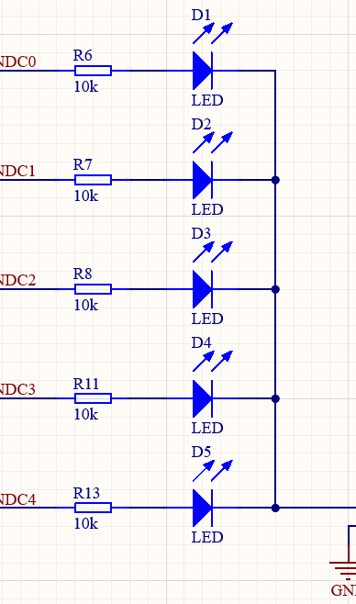
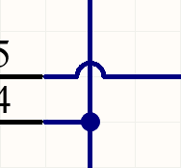
Nets and Nodes
Schematic Nets are how components are electrically connected in a circuit
Represented with lines between components
Nodes/Junctions are locations where wires split in two (or more)
A connection on a node is denoted by a dot

Slide 12
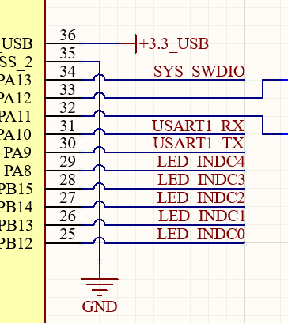
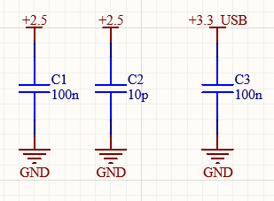
Net Labels
Net Labels allow electrical connections to be made without having to draw a line between components
Net Labels tend to be local to the current schematic sheet
Power Labels tend to be global to the full design
Note: Ports are similar but have a different purpose
Useful for hierarchal / multi-sheet design

Slide 13
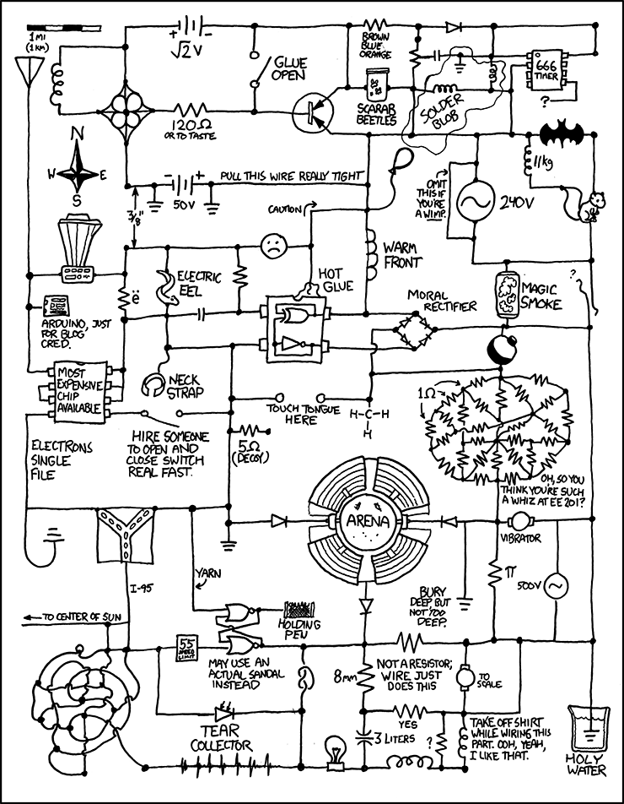
Good Schematic Practice
Readability is KEY!
The schematic needs to be read by other engineers to assist with layout and debugging
Readable schematics make it easier to find electrical errors which would be translated into the physical layout
https://xkcd.com/730/

Slide 14
Tips:
Read Left to Right
Don’t Overcrowd
Use a larger sheet or use multi-sheet drawings
Use Logical Blocks to Divide Circuit Elements
Reference Manufacturer Datasheets
Follow established layouts
Label Signals
Especially those which are not immediately obvious
Keep Power Sources at the top and GND at the Bottom

Slide 15
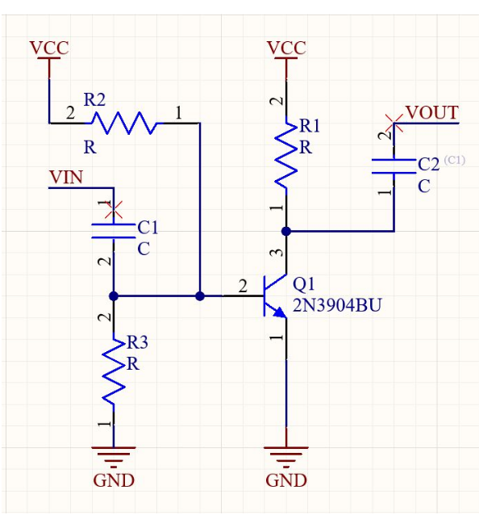
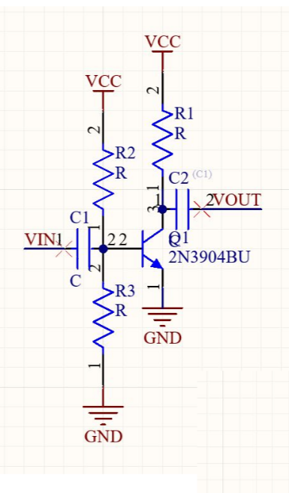
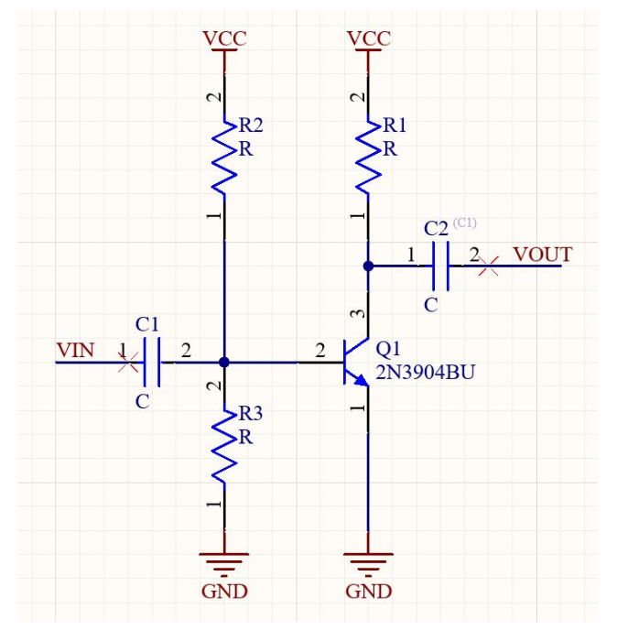
Examples:
From Nick Howard, Week01 IEEE x FSAE Workshop SP25

Slide 16





ECAD Software
ECAD (Electronic Computer-Aided Design) are software used to design and create diagrams and layouts for PCBs
There are many different vendors for ECAD software:
Altium
KiCAD
Eagle
OrCAD
EasyEDA

Slide 17
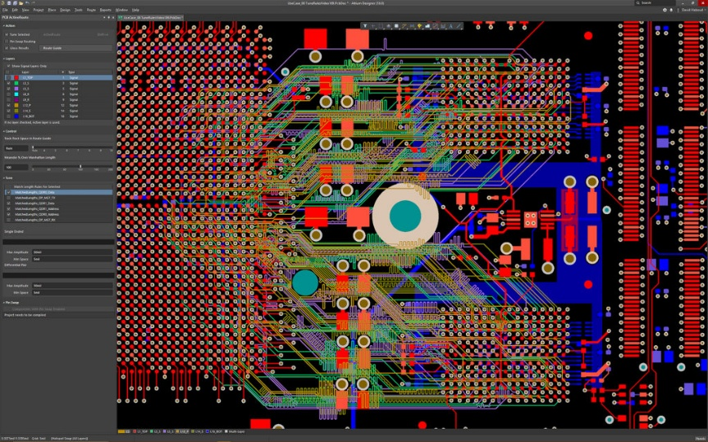

Why Altium?
Altium is very commonly used in the industry for PCB and circuit assembly
Not many opportunities to get access to the software outside of university
Please get your student license ASAP if you haven’t already
Great addition to your resume!

Slide 18
Project Introduction
USB-C Breadboard Power Supply
Dual Switching Supplies
Independent Voltage Outputs
Switch between isolated / tandem supplies
Dual Input Supplies
Primary and Secondary Supplies
Terminal Block Input
USB-C PD trigger on Primary Supply
Additional Barrel Jack DC input
Configurable output bleeder resistors

Slide 19
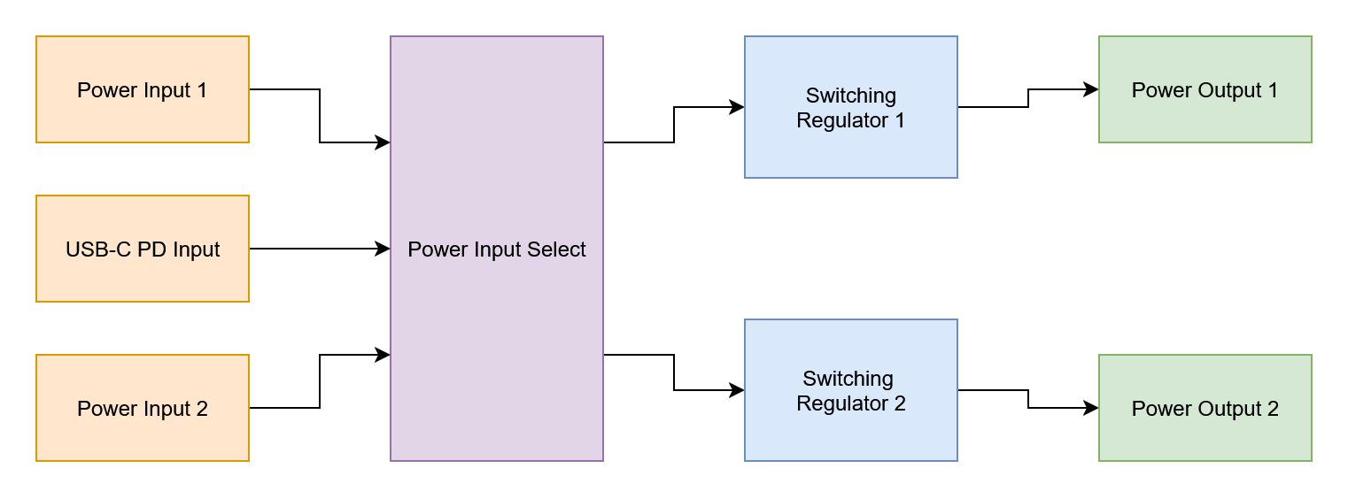
Block Diagram
Block diagram drawn using draw.io

Slide 20
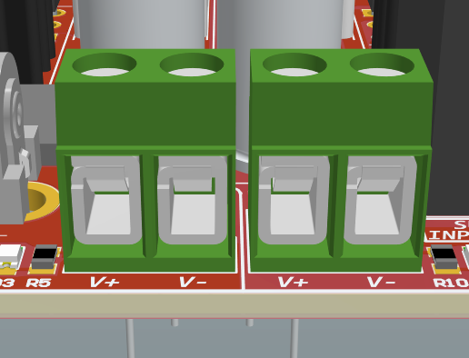
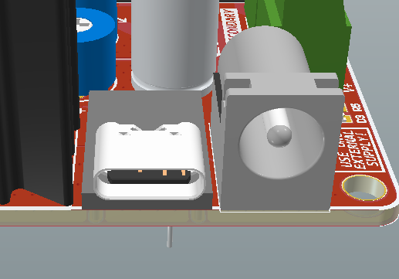
Power Inputs and Input Selection
Power Inputs
Terminal Block Input
Barrel Jack Input
USB-C PD Breakout
20 VDC Max
Input Selection
Select between a primary and secondary supply
Isolate supply A and B for independent operation

Slide 21
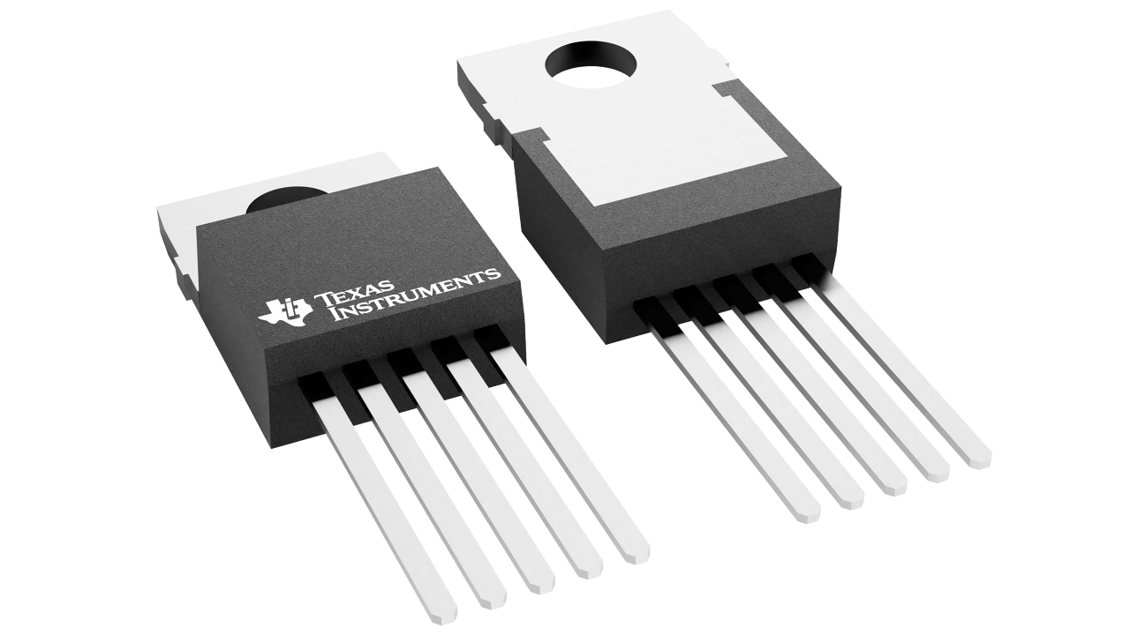
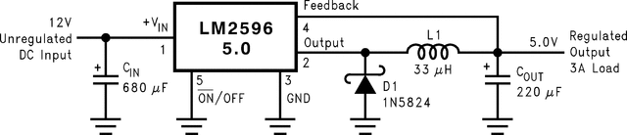
Switching Supplies
Texas Instruments Simple Switchers – LM2596
Buck Converter
Adjustable Output
3 Amp Output Load Capacity
Reference Datasheet for more information and reference circuit
https://www.ti.com/product/LM2596

Slide 22
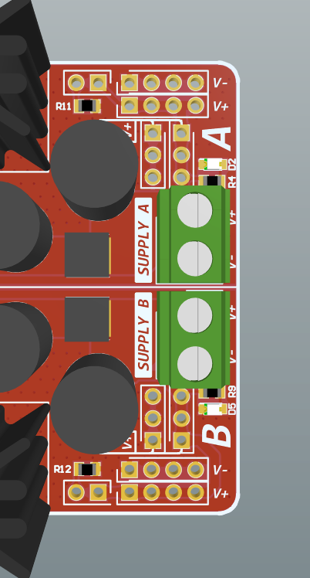
Power Outputs
Power Outputs
Terminal Block Output
Pin Headers
Breadboard width for easy utilization
Output Bleeder Resistors

Slide 23
Questions?
Questions?

Slide 24
Download Today’s Project Files
Navigate to the workshop GitHub and download today’s files https://github.com/IEEE-U-of-U/IEEE-PCB-Workshop-Fall-2025

